Slide 1

Discovering
and
Improving

Slide 2
Tasks
Menu
Task 1 – Alphabet Challenge
Task 2 – Spelling the words
1
2
3
4
5
Task 3 – Word salad
Task 4 – It’s time for lunch!
Task 5 – The Ant and the Grasshopper
Task 6 – Shuffle
6
Task 7 – Memory Game
7
Task 8 – Battleship Game
8
Task 9 – Colour Game
9
Task 10 – How about fishing?
10
Task 11 – Collecting letters
11
Task 12 – Listening activity
12
Task 13 – Spelling skills
13

Slide 3



Task 1
Alphabet
Challenge
Click on the to hear the letter.
Click on the letter and discover the word.
Click to go back to the alphabet page.

Slide 4
Choose a letter.
Task 1
A | B | C | D | E
F | G | H | I | J
K | L | M | N | O
P | Q | R | S | T
U | V | W | X | Y | Z

Slide 5
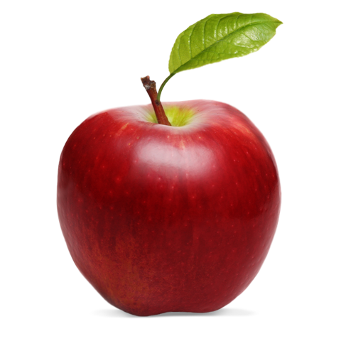
A is for
Apple

Slide 6

B is for
Book

Slide 7
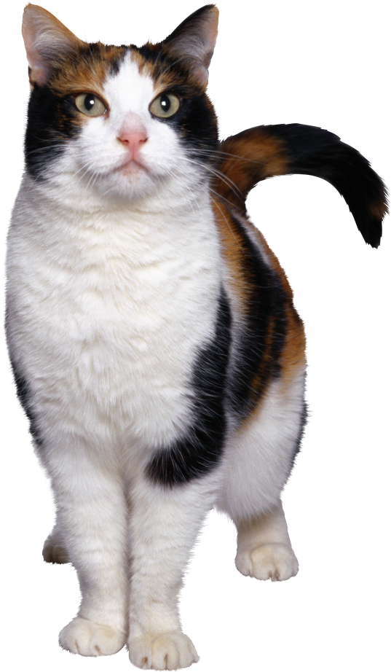
C is for
Cat

Slide 8

D is for
Door

Slide 9

E is for
Egg

Slide 10
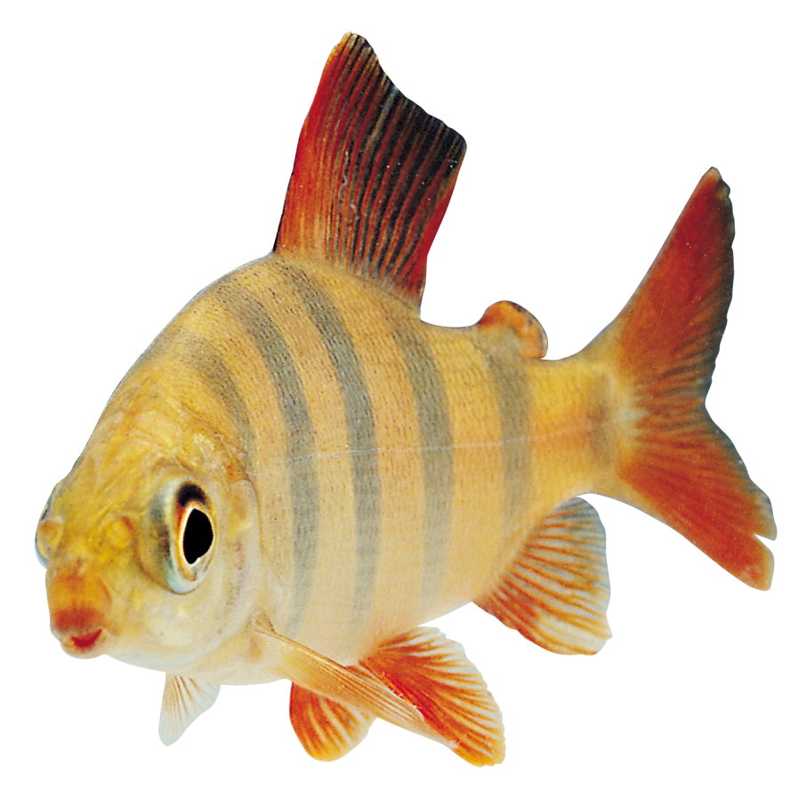
F is for
Fish

Slide 11
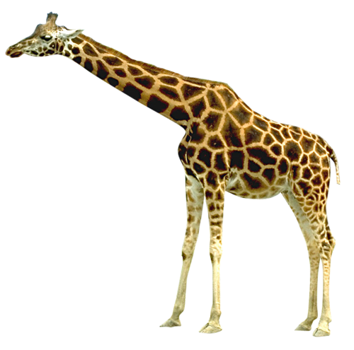
G is for
Giraffe

Slide 12
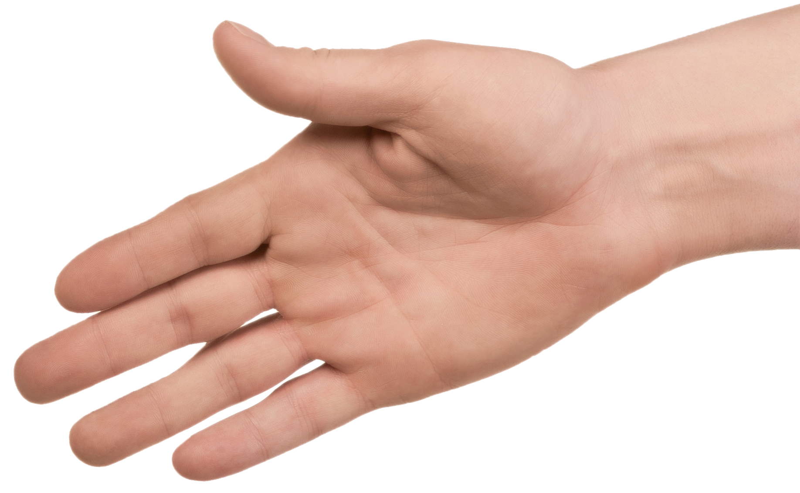
H is for
Hand

Slide 13
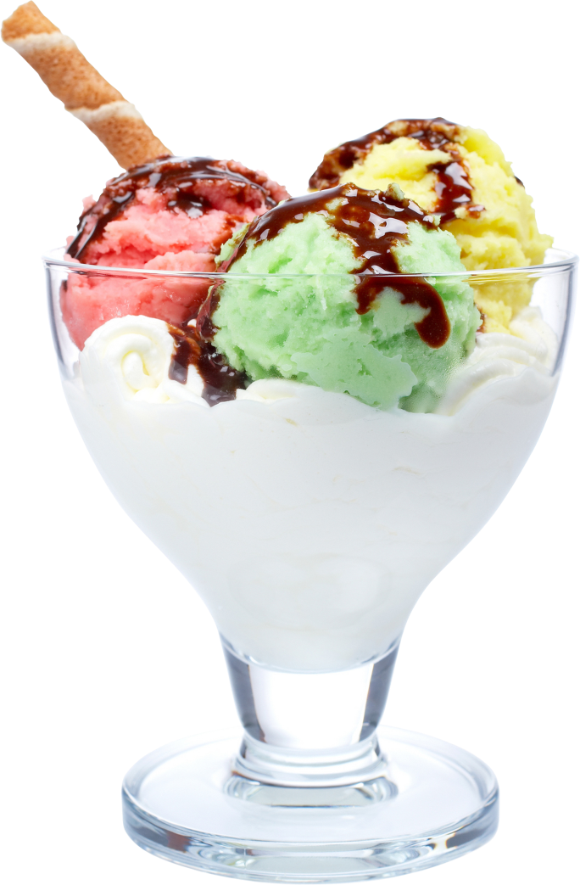
I is for
Ice cream

Slide 14
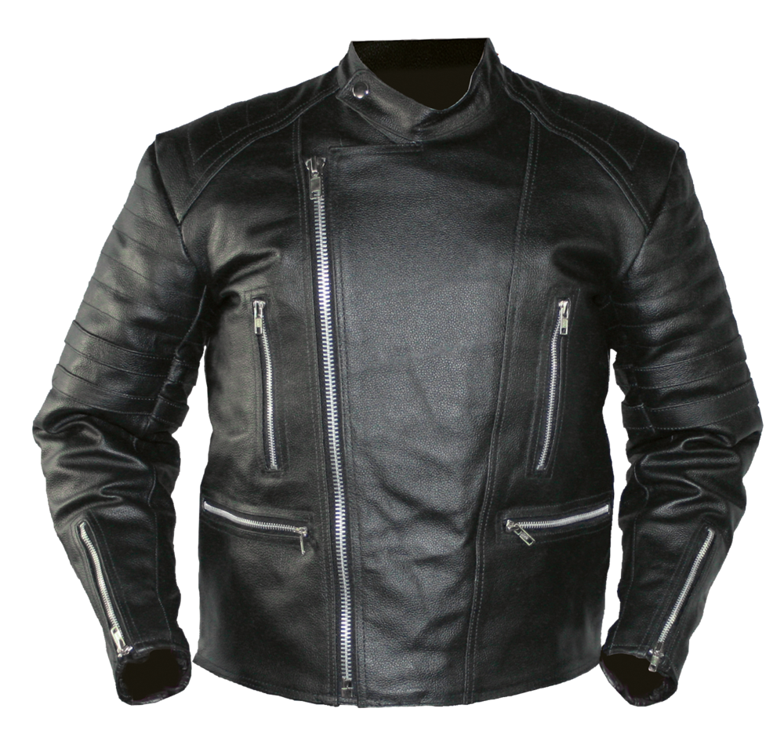
J is for
Jacket

Slide 15
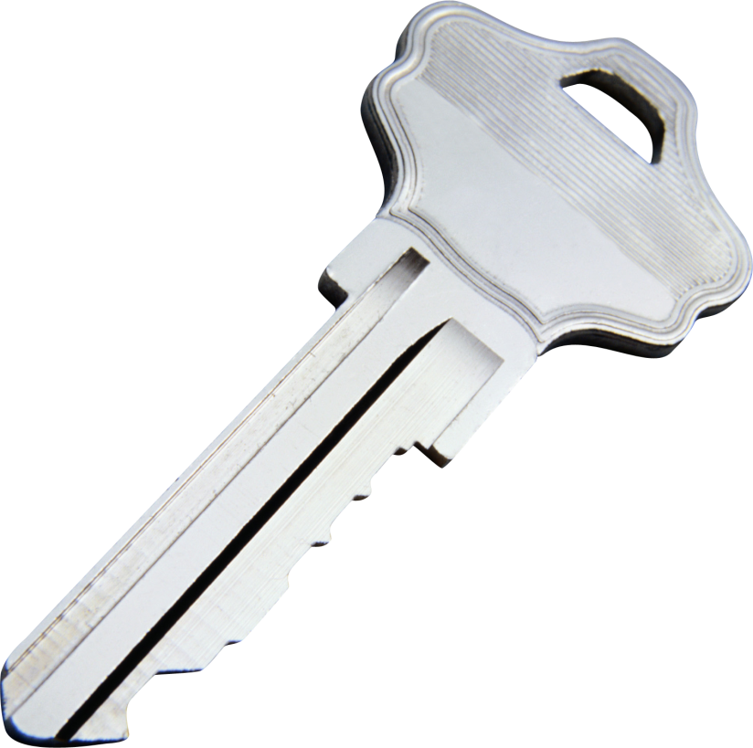
K is for
Key

Slide 16
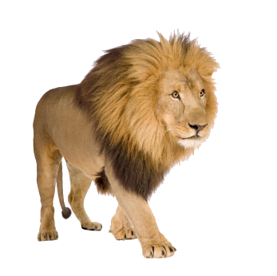
L is for
Lion

Slide 17
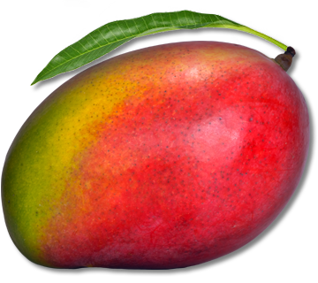
M is for
Mango

Slide 18



N is for
Numbers

Slide 19

O is for
Orange

Slide 20
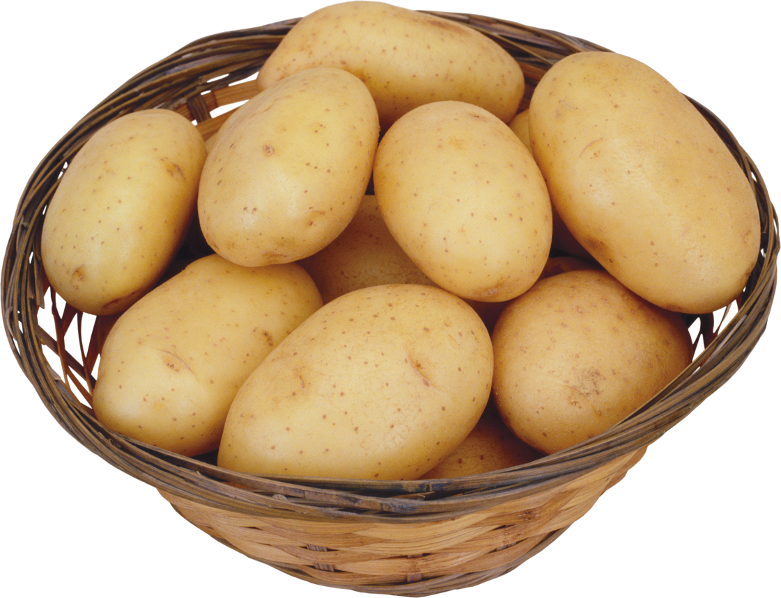
P is for
Potatoes

Slide 21

Q is for
Question

Slide 22
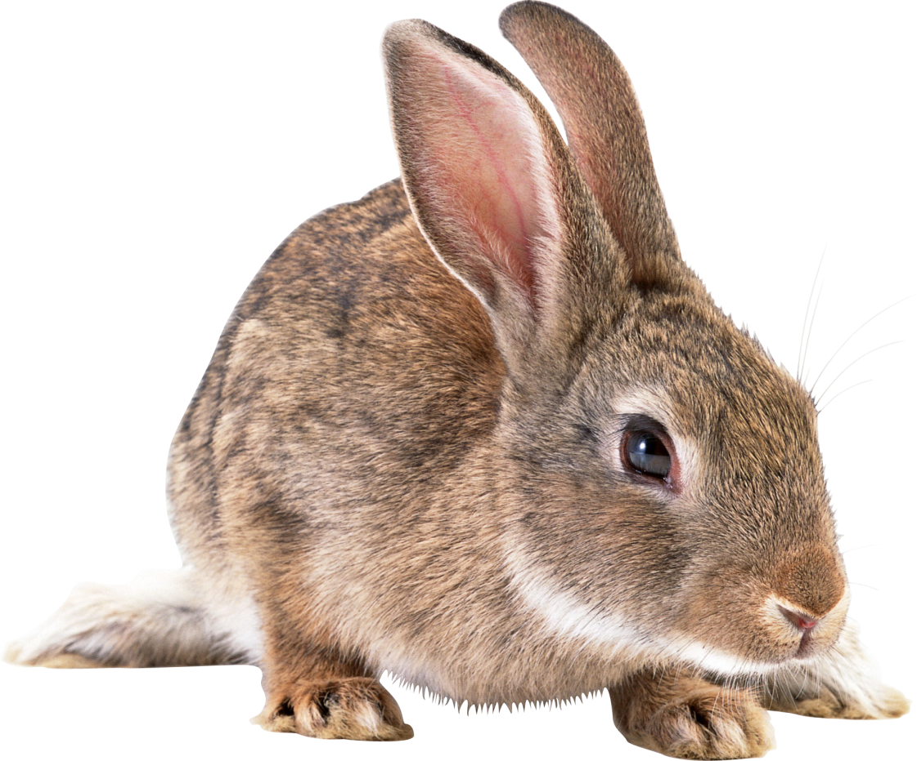
R is for
Rabbit

Slide 23
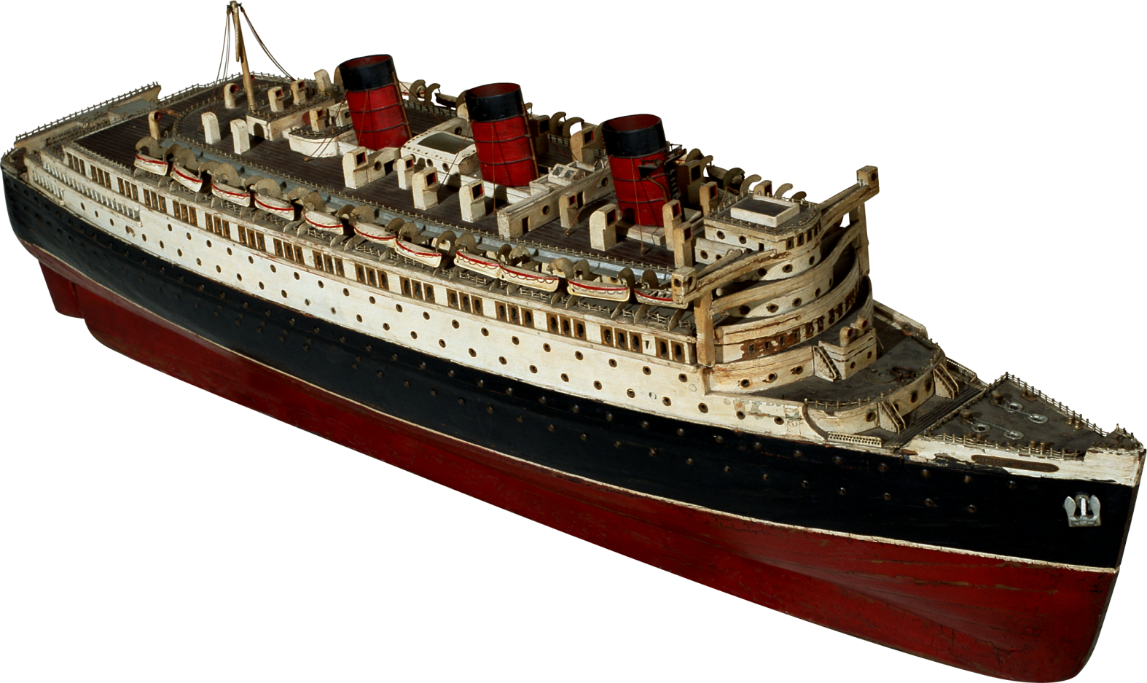
S is for
Ship

Slide 24

T is for
Tree

Slide 25

U is for
Umbrella

Slide 26

V is for
Violin

Slide 27
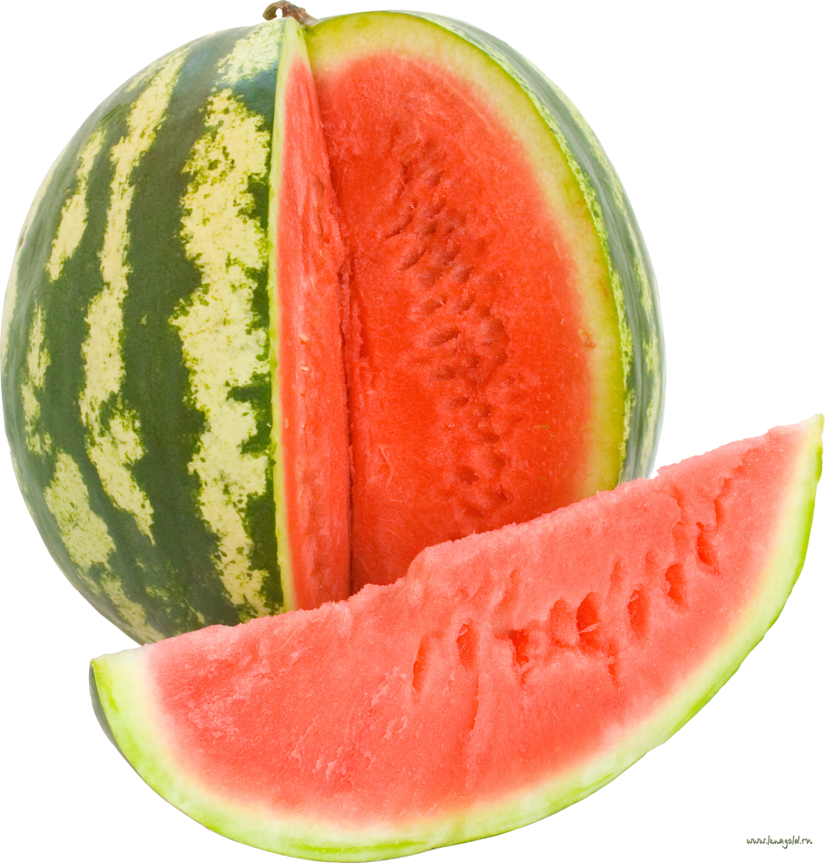
W is for
Watermelon

Slide 28
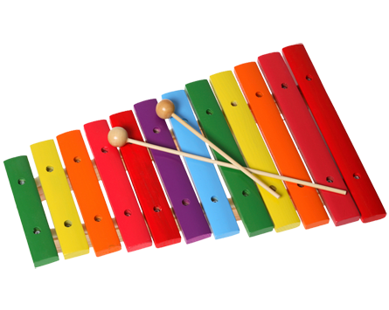
X is for
Xylophone

Slide 29

Y is for
Yellow

Slide 30
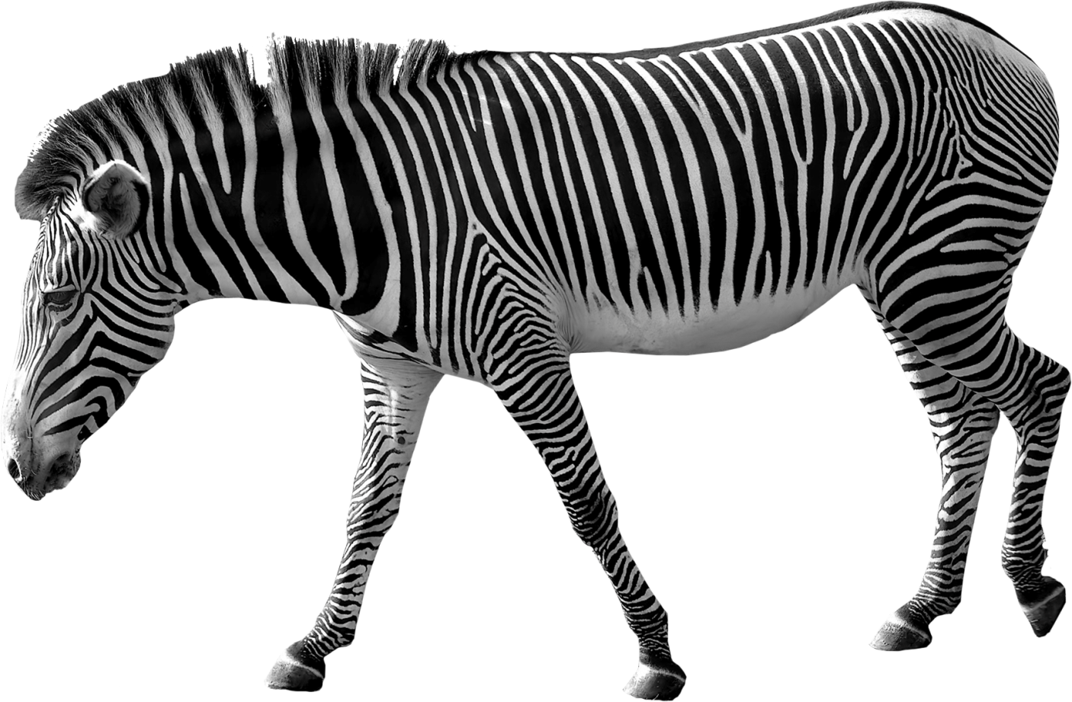
Z is for
Zebra

Slide 31


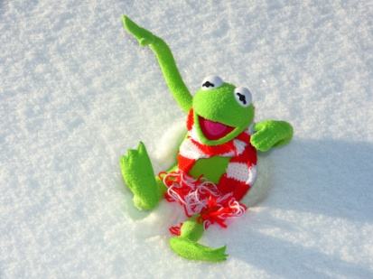


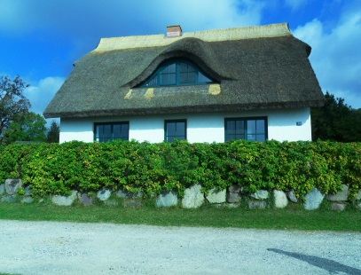

Task 2
Spell the words completing with the missing vowels.
T ____ M _____
F ____ N
I
E
D ____ Y S
U
A
I
S ____ N N Y
A
O
U
U
R ____ _____ N Y
H ____ _____ S E

Slide 32
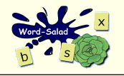


Task 3
Unscramble the words.
Game:

Slide 33
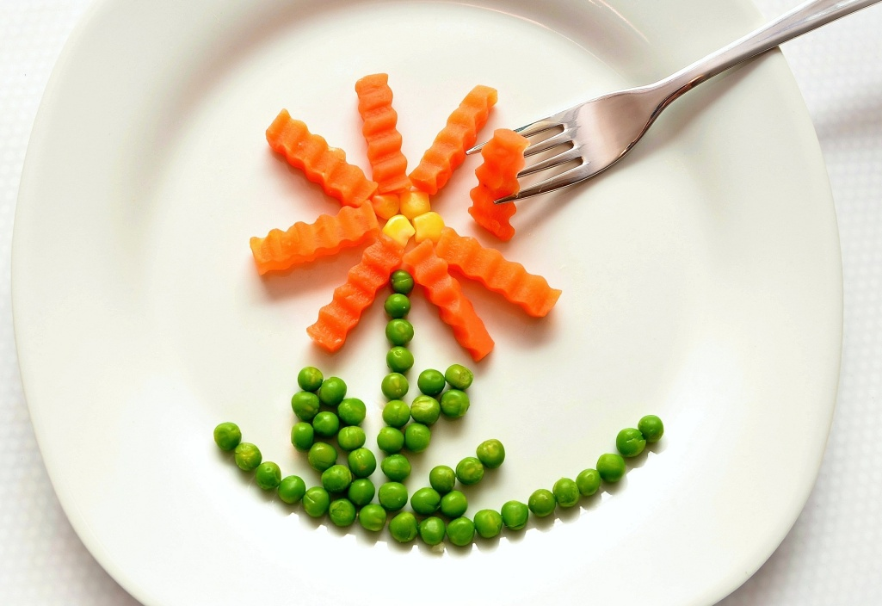
Task 4
It’s time for lunch!

Slide 34
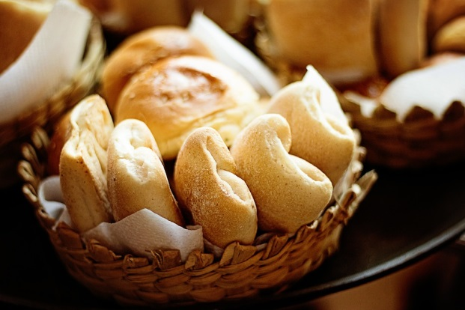
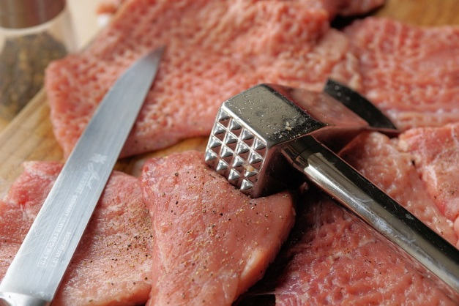
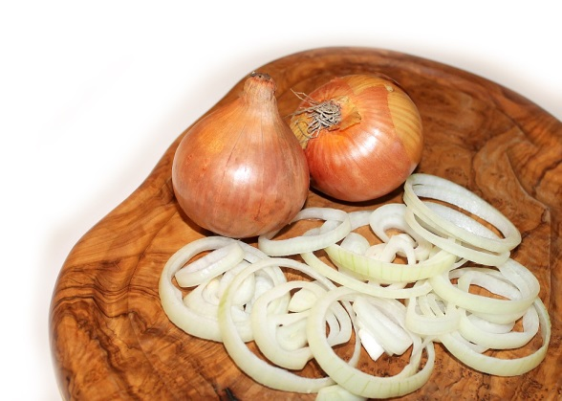
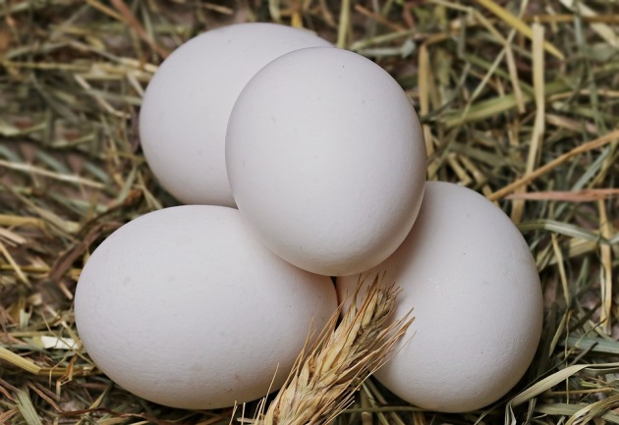
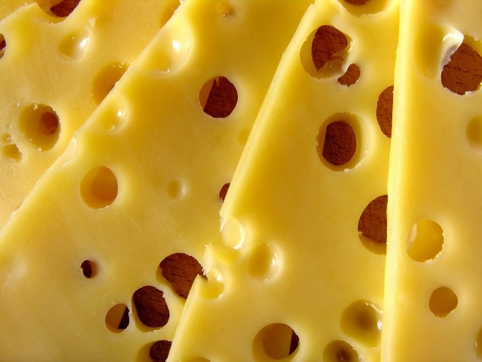
BREAD
MEAT
ONIONS
EGGS
CHEESE

Slide 35
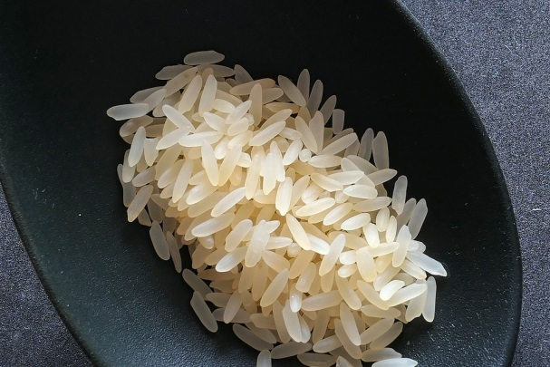
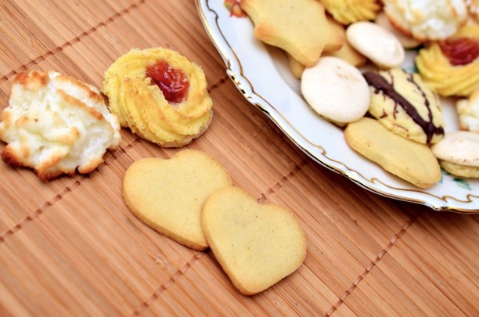
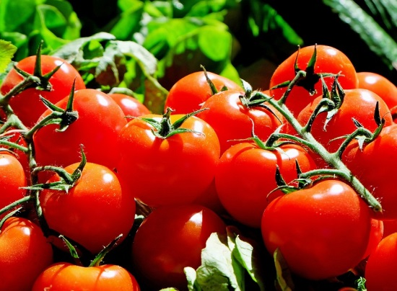
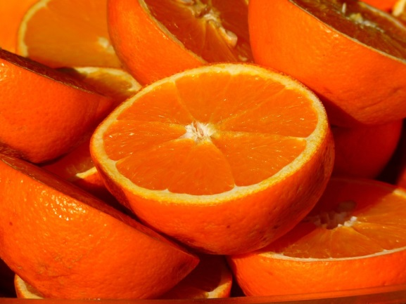
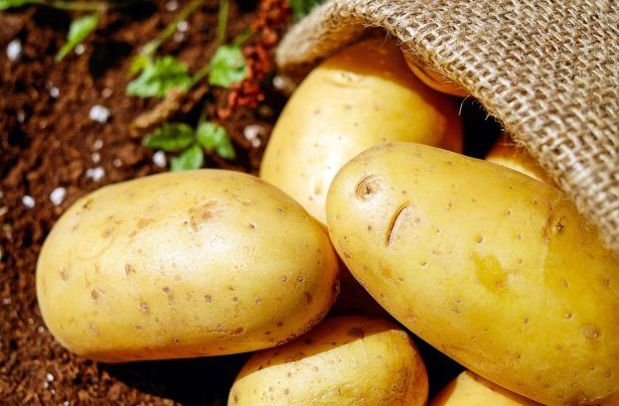
RICE
COOKIES
TOMATOES
ORANGES
POTATOES

Slide 36



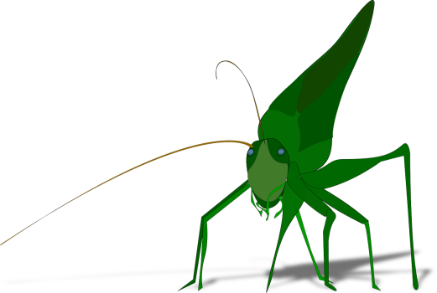
Task 5
Cloze activity.
The Ant and the Grasshopper

Slide 37
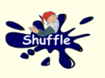
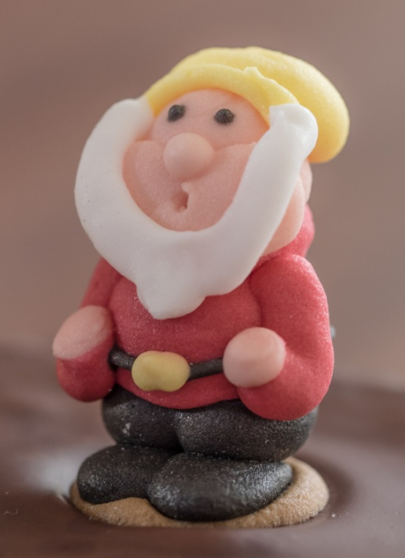
Task 6
Try to write the given word, pushing the letters.
Game:

Slide 38

Task 7
Memory Game.

Slide 39
NUMBERS (1 TO 20)
ONE
1
TWO
2
3
4
5
6
THREE
FOUR
FIVE
SIX
SEVEN
7
EIGHT
8
NINE
9
TEN
10
ELEVEN
11
TWELVE
12
THIRTEEN
13
FOURTEEN
14
FIFTEEN
15
SIXTEEN
16
SEVENTEEN
17
EIGHTEEN
18
NINETEEN
19
TWENTY
20
Hide All
Show All
Notes:
Click on a number to make the square disappear.
Click on the text underneath to replace the number.
Click on hide all to reveal all the text.
Click on show all to show all the numbered squares.

Slide 40
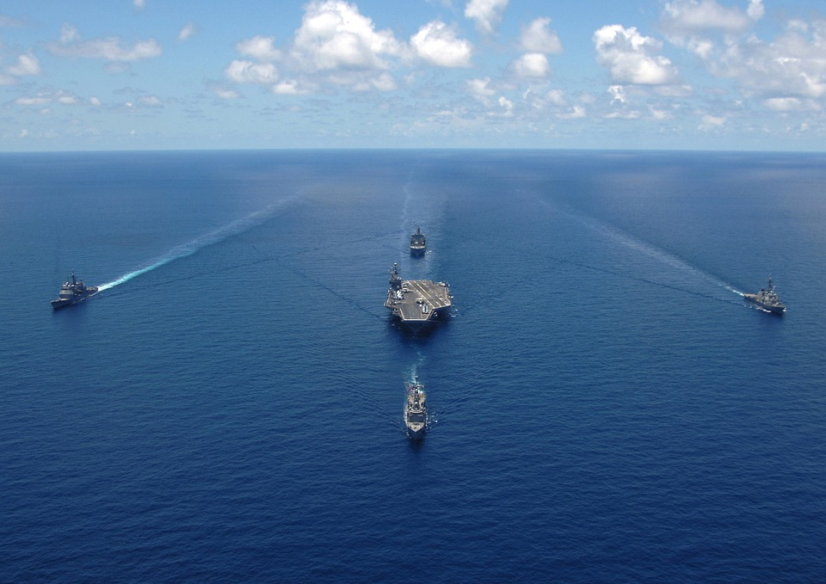
Task 8
Battleship Game.

Slide 41
1
2
3
4
5
6
7
A
IN
UNDER
IN FRONT OF
OVER
BELOW
NEAR
ONTO
A
B
ON
DOWN
NEXT TO
BESIDE
INSIDE
ACROSS
OFF
B
C
BETWEEN
OUT
ABOVE
FAR
THROUGH
AWAY FROM
TO
C
D
UP
BEHIND
AMONG
AROUND
INTO
OUT OF
ALONG
D

Slide 42

Task 9
Colour Game.

Slide 43


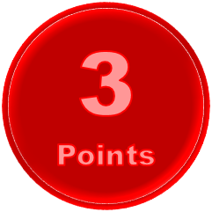
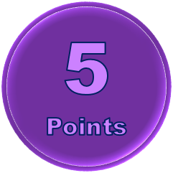
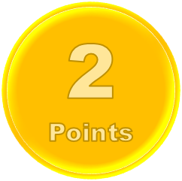
WORD
WORD
WORD
WORD
WORD
BLA
WORD
WORD
Colours
WORD
WORD
WORD
WORD
WORD
WORD
WORD

Slide 44
DARK BLUE

Slide 45
BLA
WHITE

Slide 46
BLACK

Slide 47
ORANGE

Slide 48
RED

Slide 49
YELLOW

Slide 50
PURPLE

Slide 51
PINK

Slide 52
LILAC

Slide 53
LIGHT GREEN

Slide 54
LIGHT BLUE

Slide 55
DARK
GREEN

Slide 56
GREY

Slide 57
BROWN

Slide 58
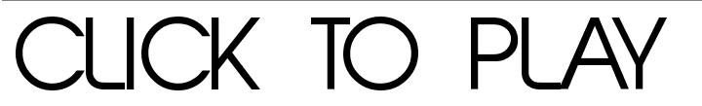

Task 10
Choose the correct answer.

Slide 59

How about
Fishing?

Slide 60
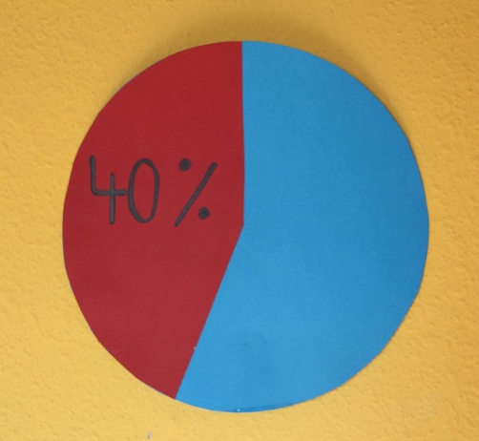
Which word is wrong?
A. FOURTY
B. FORTY

Slide 61

Scoring

Slide 62

Which word is right?
A. PORTUGESE
B. PORTUGUESE

Slide 63
Scoring

Slide 64

Which letter is missing in EXIST__NCE ?
A. Letter E
B. Letter A

Slide 65
Scoring

Slide 66

Which is the correct spelling?
A.TUESDAY
B.TUSDAY

Slide 67
Scoring

Slide 68

Which vowel is missing in
D__C__MB__R ?
A. VOWEL I
B. VOWEL E

Slide 69
Scoring

Slide 70

Which is correct?
A.BEGINNING
B.BEGGINING

Slide 71
Scoring

Slide 72

Complete: Do you like watching _____ fiction movies?
A.SCINCE
B.SCIENCE

Slide 73
Scoring

Slide 74
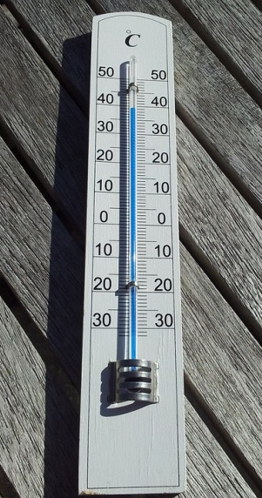
Complete:
The ________ is great.
A.WETHER
B.WEATHER

Slide 75
Scoring

Slide 76
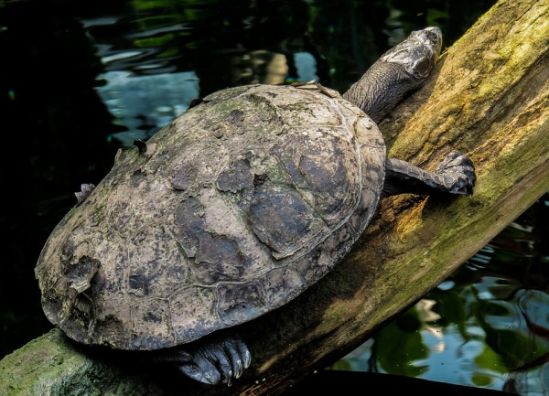
Complete the word: TORTO____.
A. ESE
B. ISE

Slide 77
Scoring

Slide 78
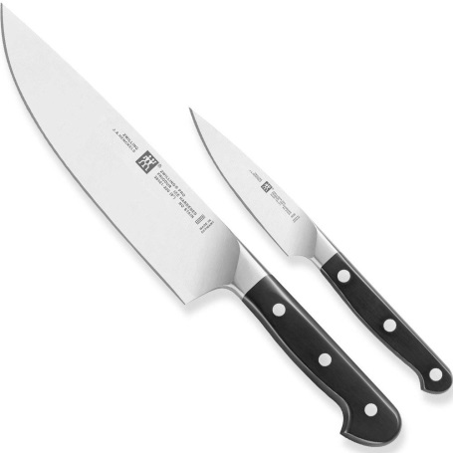
The plural of knife is …
A. KNIFES
B. KNIVES

Slide 79
Scoring

Slide 80
Good job!

Slide 81
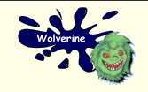


Task 11
How about another game?
Try to collect as many right letters and dots as possible.
Game:

Slide 82
Task 12
Listening activity.
Complete the gaps orally.
PAPER – WEAK – LADDERS – COMPUTERS
LETTERS – WEEK – BUSY
busy
E-mail certainly keeps me ________. I never used to write as many __________ as I do now. In the good old days before _______________, we wrote real letters, with ___________ and envelopes. I wrote one or two letters a ___________. But now, with e-mail, my in-box is never empty.
Taken from: http://www.listenaminute.com/e/e-mail.html
letters
computers
paper
week

Slide 83
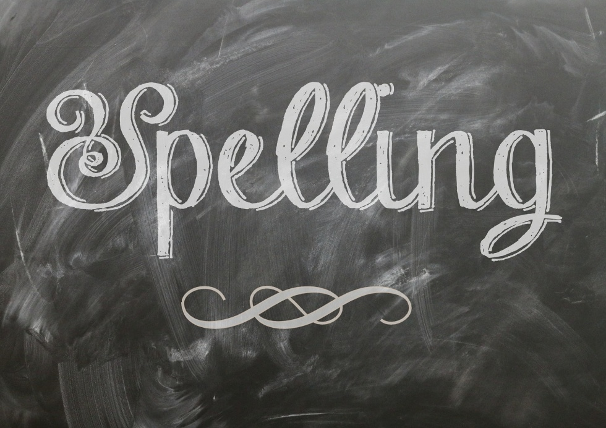
Task 13
Test your spelling skills.

Slide 84


Slide 85
Developed by Mayara Nespoli
mayaranespoli@gmail.com
Web sites:
http://www.free-power-point-templates.com/
http://powerpointgames.wikispaces.com/PowerPoint+Game+Templates
https://hotpot.uvic.ca/
http://www.listenaminute.com/e/e-mail.mp3
http://www.wordcentral.com/games/alpha-bot.html
http://www.legasthenie-software.de/cgi-bin/wwwklex.prg
http://www.education.vic.gov.au/LANGUAGESONLINE/games/memory/index.htm
https://tekhnologic.wordpress.com/2016/12/27/10-powerpoint-games/

